Slide 1
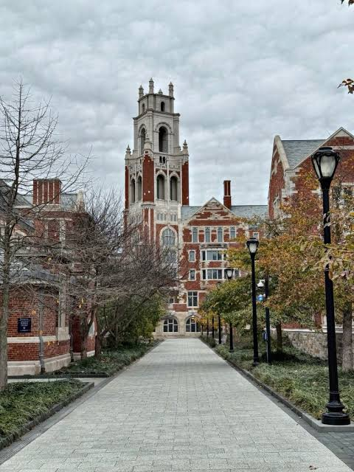

FINDING
YOUR CALLING
Pursuing purpose in college…and beyond.
TYREN BROWN, MPH (c)
Class of 21’
Aspiring Physician • Public Speaker
Community Health Researcher
For the Senior Class

Slide 2

2
Where we're going
Impact before title
3 Different Students
Discover your calling
Pursue & cultivate it
My journey
Your first-year challenge
“You don't need your whole life figured out.
You need a direction worth exploring."
TYREN BROWN, MPH (c) • FINDING YOUR CALLING

Slide 3
3
Changing the Question
What do you want to do?
What impact do you want to make?
→
MAJOR
CAREER
CALLING
What you study
What you do
The impact you pursue
“If money and expectations disappeared for a minute, what problem would you want to help solve?"
TYREN BROWN, MPH (c) • FINDING YOUR CALLING

Slide 4
WHICH ONE ARE YOU?
4
There Are 3 Paths
1 I KNOW MY MAJOR
2 I HAVE A MAJOR... FOR NOW
3 I DON'T KNOW YET
You have a direction.
Stay curious anyway.
You may change it.
That's normal.
You have room to explore.
That's normal, too.
All to which our natural and a part of the journey!! EMBRACE IT!
TYREN BROWN, MPH (c) • FINDING YOUR CALLING

Slide 5
A WORKING DEFINITION
5
Calling, not just major
WHAT MATTERS TO ME?
WHAT AM I GOOD AT?
WHO DO I WANT TO SERVE?
WHAT PROBLEM CAN I HELP SOLVE?
Your calling can sit at the intersection.
You may not know the answer today, perhaps maybe not even tomorrow…. College gives you places to test it.
TYREN BROWN, MPH (c) • FINDING YOUR CALLING

Slide 6

DISCOVER
6
Treat college like a Chilli
TRY
SERVE
Take a class outside your comfort zone.
Volunteer, work, or intern somewhere.
ASK
ADJUST
Find a mentor and ask focused questions.
Continue, tweak, or drop the pursuit.
JOIN
REFLECT
Clarity usually comes from "movement”…not waiting idle. BE PROACTIVE
Commit to one club, team, or project.
Notice what energizes and drains you.

Slide 7
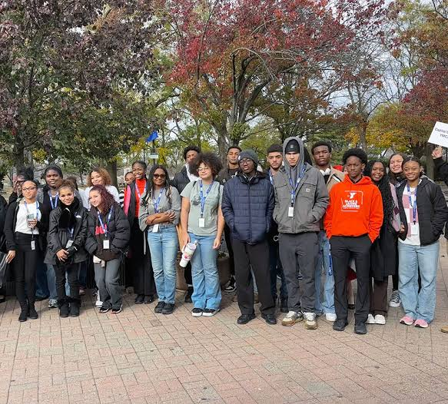
PURSUE
7
Start small. Build Confidence.Discern.
WAITING FOR PERFECT
Waiting for the perfect internship, club, or opportunity can cost you momentum can potentially stunt your growth.
Your learning opportunities rest outside the bounds of your comfort zone.
START SMALL NOW
Take the part-time role. Volunteer. Help on a project. Ask to shadow.
Small experiences build skills, relationships, and proof.
TYREN BROWN, MPH (c) • FINDING YOUR CALLING

Slide 8



GROW
8
Cultivate what you discover
BUILD SKILLS
FIND MENTORS
BUILD A Collection of Experiences
SEEK FEEDBACK
REASSESS
TYREN BROWN, MPH (c) • FINDING YOUR CALLING

Slide 9
MY JOURNEY
10
A winding path can still have direction
STUDENT
ATHLETE
(CMIT) 4yrs
→
STUDENT
ATHLETE
(Undergrad, Chicago) 4yrs
→
Master’s PUBLIC HEALTH (UMD 4yrs)
→
COMMUNITY HEALTH
→
MEDICAL SCHOOL
(4yrs)
→
RESIDENCY
5yrs)
→
?
The traditional route isn't always the best route for you.
I can know my direction without knowing every destination.
TYREN BROWN, MPH (c) • FINDING YOUR CALLING

Slide 10
ONE CHALLENGE
Don't leave college only with a degree.
Leave knowing yourself better than when you arrived.
Try. Reflect. Adjust. Keep moving.
IMPACT BEFORE TITLE.
Questions?
TYREN BROWN, MPH (c) • FINDING YOUR CALLING

Slide 11

TYREN BROWN, MPH (c)
ASPIRING PHYSICIAN
Public Speaker • Community Health Researcher
Professional Development
CONNECT WITH ME
LinkedIn — Tyren Brown
Email — TheAnatomyofImpact@gmail.com
Website — TheAnatomyofImpact.com
Impact before title.

